Slide 2

New York City Arts
April 25th – 28th, 2024

Slide 3
Who am I? Mr. Ahl
I have worked in the district for the past 7 years and have run the Drama Club/Directed the school musical for the past 4.
I am the Executive Director of The Olean Theatre Workshop where I teach a high school level Theatre class.
Travel
I have taken students to Europe three times (Paris, London, Barcelona, Madrid) with both Allegany-Limestone and Olean.
I have taken Allegany-Limestone students to NYC in 2018.
Personal travel - I lived in Montpellier, France where I traveled through France and Spain, and I go to NYC every year.
Why travel
It makes us a well-rounded global citizen that have the know how to travel while having the security of a trusted group of adults.
Promotes flexibility, independence, confidence, and an appreciation for the world around us.
Students will see history and the arts come to life.

Slide 4
Benefits of Educational Travel

Slide 5
Benefits of Educational Travel
Expanded worldview
  Understanding and appreciation of different cultures
Personal growth
  Increased confidence and competence
  Becoming more flexible with working with others.
Life skills
  Demonstrates maturity and worldliness
  Enhances college and job applications

Slide 6
Who we’re traveling with
Proven experience
  50 years in student travel
  More than 1 million travelers
  Tours to 75 countries on all 7 continents
Excellent value
  Fully inclusive
  Quality hotels, meals & activities

Slide 7
Why Explorica?
Incredible tour directors
  Professionally trained
  Specialized in student travel
  Local experts bring the destination to life
  With group 24/7
Exceptional safety record
  Proven systems in place at all levels of operations
  Worldwide network of support
  Unmatched in industry

Slide 8
By your side, always
Proactive risk management
Expertly trained, multilingual tour directors
24/7 emergency support
Daily tour updates
Global vigilance
Network of 45+ offices around the world
Comprehensive liability coverage
Trusted travel protection plans
Upgraded plans available

Slide 9
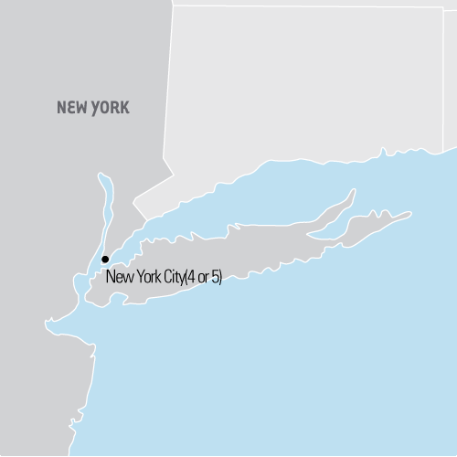
Where we’re going
New York City Arts
April 25th – 28th, 2024
Length: 4 Days
Walk through bustling Times Square, tour the Metropolitan Art Museum, stroll through Central Park to see Strawberry Fields and the open-air Delacorte Theater, and cap the trip off with a workshop with a real working Broadway actor and a Broadway show.

Slide 10


Tour Itinerary
DAY 1 | Hello New York
  Meet your tour director
  Midtown walking tour
    Rockefeller Center, St. Patrick's Cathedral, Times Square, Grand Central Terminal
  Dinner
  Museum of Broadway visit
DAY 2 | New York City
  Breakfast
  Broadway workshop
  Lower Manhattan guided sightseeing tour
    Trinity Church, Wall Street, 9/11 Memorial visit, Chinatown, Little Italy
  9/11 Memorial Museum visit
  Dinner
  Broadway show
9/11 MEMORIAL
TIMES SQUARE

Slide 11


Tour Itinerary
DAY 3 | New York City
  Breakfast
  Metropolitan Museum of Art visit
  Central Park walking tour
    Cherry Hill, Strawberry Fields, Belvedere Castle, Delacorte Theater
  Radio City Music Hall guided tour
  Dinner
  Broadway show
DAY 4 | End Tour
  Breakfast
  MoMA visit
  Top of the Rock visit
  Travel home
CENTRAL PARK
TOP OF THE ROCK

Slide 12
What’s included
Round-trip transportation
Entrance fees to attractions per itinerary
Guided sightseeing tours and city walks per itinerary
Accommodation in triple or quad rooms
Full breakfast daily
Full-time, professional tour director
Hearty, authentic dinner daily
Online Tour DiaryTM, so you can follow our journey from home
24-hour emergency service

Slide 13
Protect your investment
Travel Protection Plan
Travel Protection Plan PLUS
$16/day
$24/day
This plan covers your child for:
  A traveler’s injury, sickness, or death of a
  family member
  Theft of passport or visas
  Flight cancellations due to strike or bad weather
  Loss of luggage and personal effects
  Trip cancellation or trip interruption due to covered reasons such as a covered sickness, illness, or injury
  Trip cancellation or trip interruption due to terrorist acts, as defined
This plan covers your child for:
  Everything in the standard plan
  Plus Explorica’s exclusive ”Cancel for Any Reason” protection:
    If you cancel your trip 48 hours (2 days) or more before your scheduled departure date, you will be reimbursed for 75% of the non-refundable cancellation fees, less the deposit and insurance premium

Slide 14
Easy ways to pay
Pay in full at enrollment
  Entire trip paid upon registration
  No remaining balance
  Payment rendered manually
Automatic monthly
payment plan
  $50 deposit paid upon registration
  Balance divided into equal monthly installments
  Payments charged automatically
Manual payment plan
  $99 deposit paid upon registration
  Balance divided into 2 installments. The first installment of $150 due 30 days after enrollment & Full balance is due 95 days prior to departure
  Payments rendered manually

Slide 15
Academic Credit
  Students can complete assignments after the tour for academic credit.
  This option provides the opportunity to earn high school and/or college credits for their travel experience.
  Email academiccredit@explorica.com for more info.
High school credit
  Students can choose a course paired with this travel program to receive a high school half credit, and work at their own pace to complete online classes within three months of the tour.
College credit
  Explorica partners with George Mason University for students to pick a course option for 1 college credit. They then work at their own pace to complete online classes within three months of the tour.

Slide 16
Easy ways to pay
Fundraising support
  Personal fundraising page on explorica.com
  Easily request and accept credit card donations from friends and family
  Through Drama Club – Ads and Patrons

Slide 17
Give your child
Explore exciting destinations
Create lifelong memories and new friends
Grow and mature as a person
Prepare for a successful future

Slide 18
Rolling Enrollment grades 9-12
Drama Club – Feb 28th – March 9th
Enrollment in a music course – March 10th – March 16th
Enrollment in an art course – March 17th – 23rd
Any other students - March 24th on…
Capacity is 55 students and chaperones
(8:1)

Slide 19
You can enroll your child through and of the following methods:
  Online at www.explorica.com/Ahl-1329
  By phone at 1.888.310.7121
  By mail when you complete the paper application and send it to Explorica
    Explorica by WorldStrides
    P.O. Box 9033
    Charlottesville, VA 22906-9033
    $50 off if signed up before
    April 1st.
    Price: $1,210

